Slide 1
CALCULATOR(PHOTO VAULT)
Subject Name: software testing for mobile application
Subject Code :- CSA3732
FACULTY Name
MRS.Anitha
Saveetha School Of Engineering
Student name:
P aswini - 192011399

Slide 2
AIM
This is to create calculator which is used for:
* Addition
* Subtraction
* Multiplication
* Division of numbers
Goal is to act as a front for private images and files.
Users can upload secret pictures and videos to calculator vault apps, hidden behind a password.

Slide 3
ABSTRACT
Calculator# – Vault is an improved security tool that is disguised as a calculator
nobody would ever know what's inside such icon.
Since this icon is password protected, not nobody can access your private data.

Slide 4
INTRODUCTION
Calculator Vault is an ingenious app that lets you hide private photos, videos, and other apps within an app that looks like a calculator.
Using this app is very simple. When you tap on Calculator Vault, you'll see what appears to be nothing more than a calculator. When you open the app for the first time, you enter a PIN that becomes the secret key to open the vault.
Every time you enter the secret code, Calculator Vault opens the app's hidden vault. To import the apps and other content you want to hide, just tap the symbol located at the bottom of the screen (it's a +). You can select from anything already stored on your smartphone..
Calculator Vault is a great way to protect your privacy by hiding Photos and other files behind a basic calculator app.

Slide 5
ADAVANTAGES (MAIN FEATURE)
Import and hide pictures, hide video from photo gallery.
Use unlock function from photo & video locker when you want to show pictures and video in mobile gallery.
Multiple Photo & Video share in whatsapp, gmail, snapchat, facebook, tik tok and twitter with your friends.
Import document files such as word, ppt, pdf, text, excel, mp3 audio, call recording etc.
Easy to delete and recover photo, video, document from calculator vault app.
Fake Cover App Lock that can be lock your apps and its cover with force close screen which simulates that opened app is closed by error. only you know the trick to get real app lock and open your apps. You have multiple options for this setup.

Slide 6
EXISITING WORK
In Calculator
A calculator is a device that performs arithmetic operations on numbers. Basic calculators can do only addition, subtraction, multiplication and division mathematical calculations.
In Locker apps
In Photo Gallery, select the photos you want to hide and tap on the Share button. Choose Photo Locker on the list and pick a folder. Once you tap on the Done button, the selected photos will be transferred to the Photo Locker app and hidden in Photo Gallery

Slide 7
PROPOSED WORK
A simple calculator interface that also acts as the CALCULATER to enter the vault PIN code.
Decrypts the encrypted images and opens the photo vault when the PIN code and the selected activation button is pressed.
Hides photo activity and removes all the temporary decrypted images whenever the app goes in background or device gets locked. Opens the calculator interface when restarted.

Slide 8



APPLICATIONS :-
APPIUM
INTELLI J
ANDROID STUDIO

Slide 9
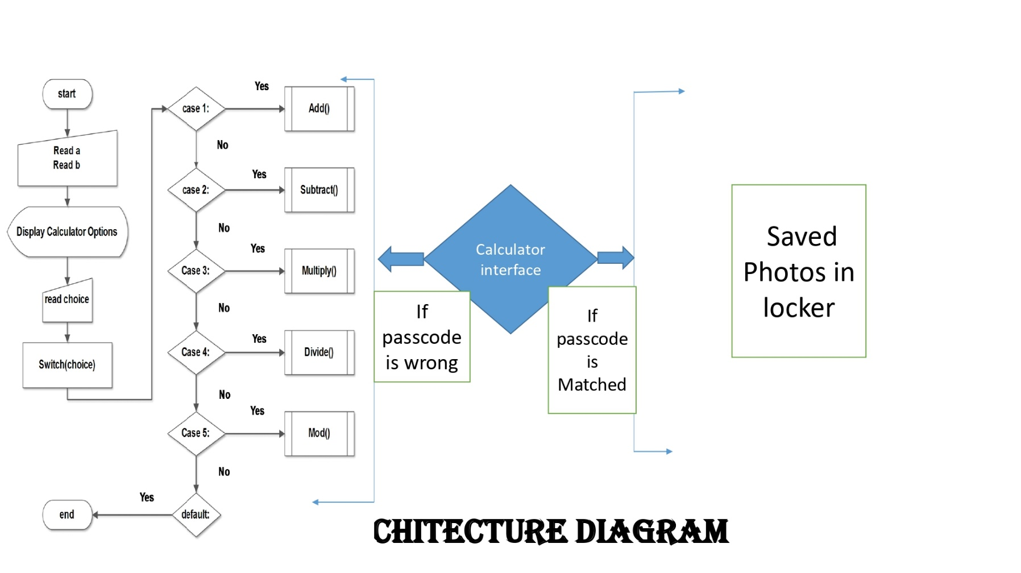
DATA FLOW DIAGRAM

Slide 10

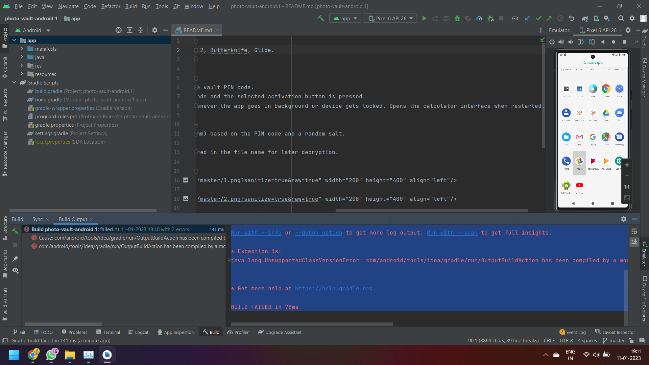
SOFTWARE & HARDWARE REQUIREMENTS
Windows laptop (Any operating System)
Android Studio
Emulater
Android software Or ( Android Mobile )

Slide 11
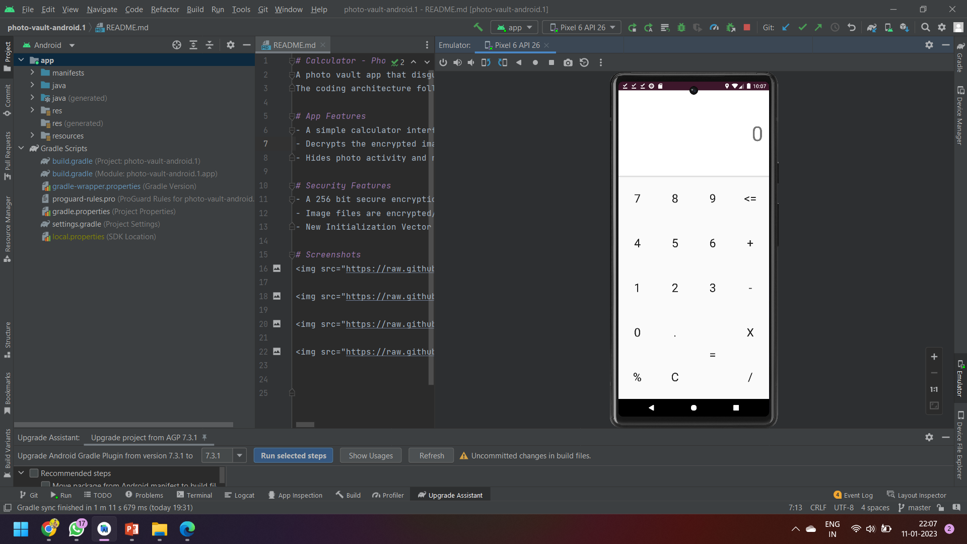
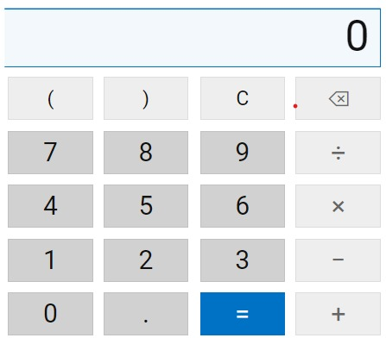
MODULE DESCRIPTION
Modular description provides the detailed information about the calculator model and its supposed components ,which is accessible in different manners .
The included description is available by reading directly ,by generating a short html description ,or by making an environment check for supported components to check if all needed types and services are available in the environment where they will be used.

Slide 12
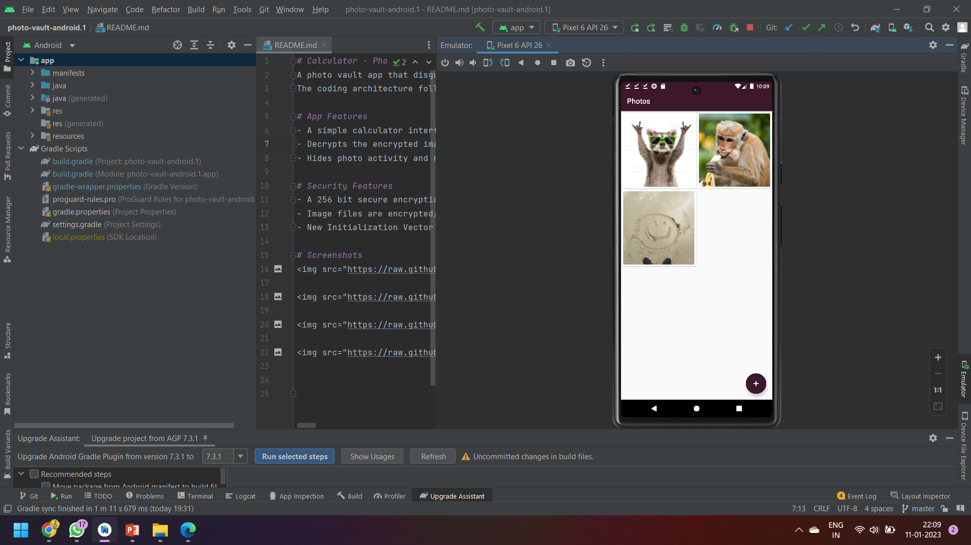
SCREENSHOT OF OUTPUT
Thus the above android application has been developed and the output was successfully executed

Slide 13
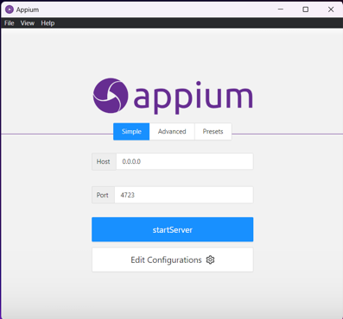
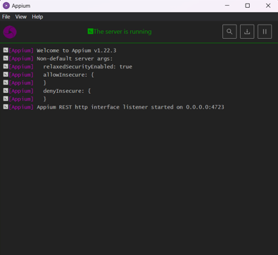
APPIUM :-

Slide 14
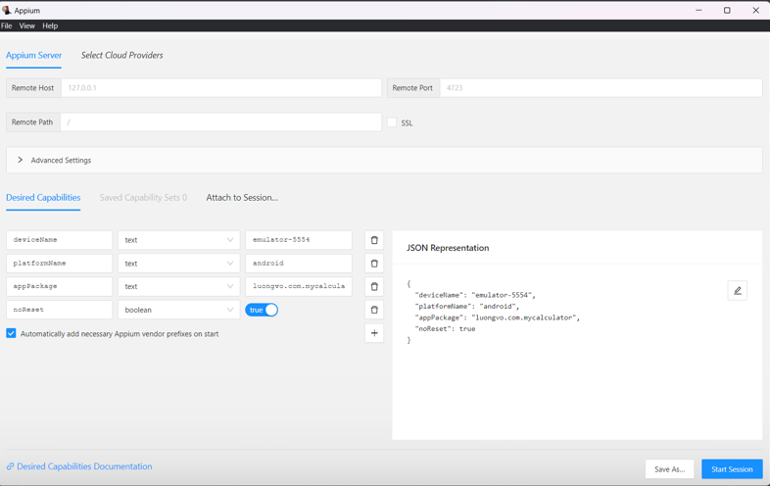
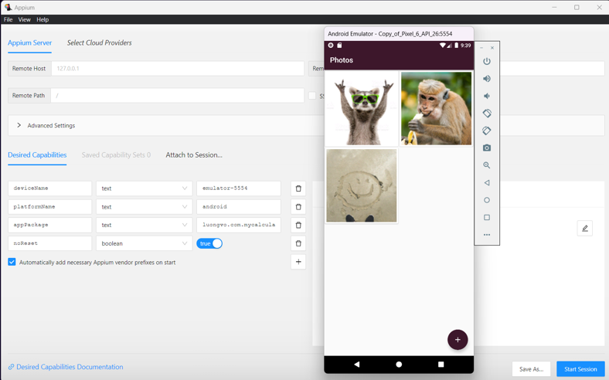
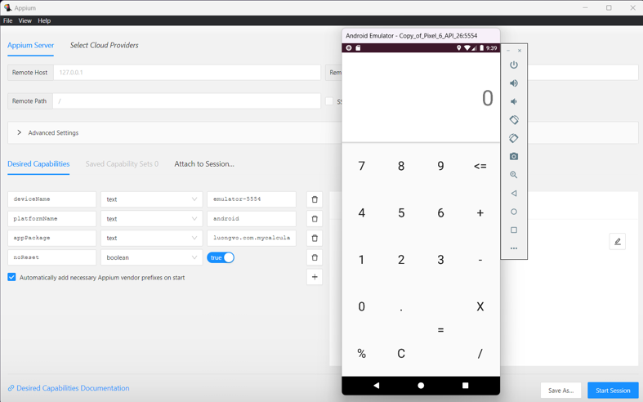

Slide 15
CONCLUSION
As a result, when reviewed in the E3 Platform, databases were able to be obtained from the device. However, the images and other files from this app were not found in the database, except for the files that were cached when I was browsing images to add in Calculator.
This led me to believe that the Calculator Photo Vault for Android encrypts all images and other files with their own encryption. This creates a barrier for your forensic tools in their ability to find this data. Since encryptions are proprietary, a large amount of time would need to be spent trying to decrypt this App.

Slide 16
REFERENCES
Android. (2017). Android debug bridge (adb), android studio. Retrieved from https://developer.android.com/ studio/command-line/adb.html (Accessed: 2018-01-27)
AppBrain. (2018). Monetize, advertise and analyze android apps. Retrieved from http://www.Appbrain.com (Accessed: 2018-01-27)
Google. (2018). Google play store. Retrieved from http://www.Play.google.com (Accessed: 2018-01-27) Harris, R. (2006).
Arriving at an anti-forensics consensus: Examining how to define and control the anti-forensics problem. digital investigation, 3 , 44–49.
Jovanovic, Z., & Redd, I. (2012). Android forensics techniques. International Academy of Design and Technology. Lessard, J., & Kessler, G. (2010).
Android forensics: Simplifying cell phone examinations. Lohrum, M. (2018). Free android forensics. Retrieved from http://www.Freeandroidforensics .blogspot.com (Accessed: 2018-01-27)

Slide 17


